Slide 1

Accenture
Innovation Challenge
Innovate to create
360° value
Let there be change

Slide 2

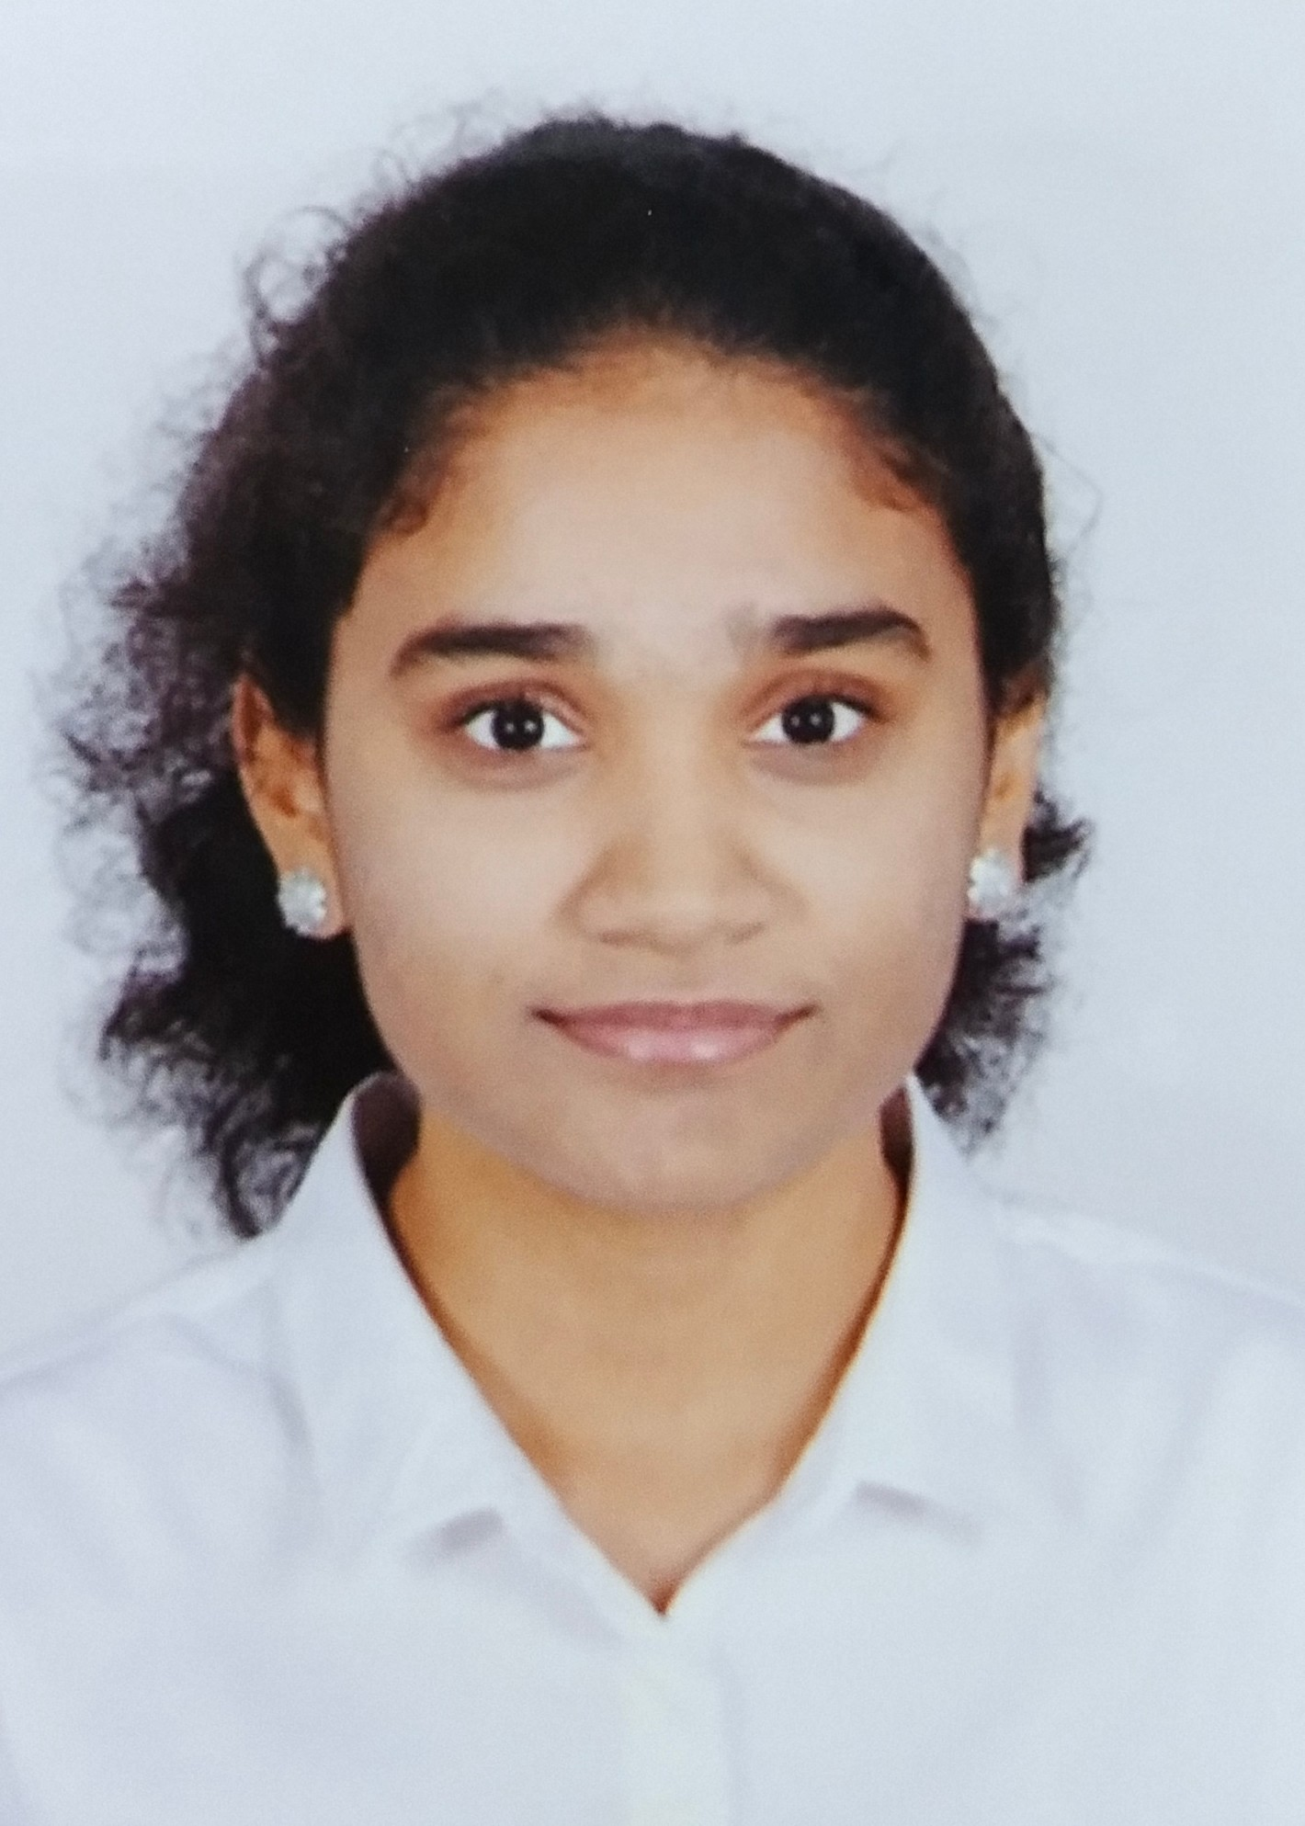
Team details
TEAM NAME: Route-1
Leena Jennifer Edwin (Team Leader)
Reena Jasmine Edwin
College: Nitte Meenakshi Institute of Technology
Stream: Computer Science and Engineering
Year of graduation:2023
College: Dayananda Sagar College of Engineering
Stream: Computer Science and Engineering
Year of graduation: 2023

Slide 3

Theme
Innovate For Society
Apply technology in innovative ways to help improve the way we work and live, and create value for our society

Slide 4
Describe the problem statement
Need for a Convenient and Simple approach for Citizens and NGOs to report and trace Potholes to ensure Accident-free and Safe roads.
Current solutions require citizens to report potholes by visiting offices, sending emails, or call the public Response Center Helpline and NGOs waste valuable time searching for potholes with vague information provided by citizens via email or address.
Why report Potholes?
With the arrival of monsoon in the nation, potholes are now the cause of a significant number of accidents and fatalities in addition to causing other problems by slowing down traffic.
Rise in the number of Road-accidents
According to data from the Ministry of Road Transport and Highways (MoRTH), there were a total of 5,626 fatalities from road accidents from 2018 to 2020 due to potholes.
Longer commuting time and affect mental health
Worsens commuters' levels of stress, sleep disruptions, exhaustion, and attention issues, especially for drivers.
Drop in Economy
On a larger scale, road accidents cause the Indian economy to lose close to 3% of its GDP annually, or Rs.55,000 crore. If the bad road infrastructure is not fixed soon,it might drop anywhere from 7 to 22% over the next 24 years.
Increased Fuel Consumption

Slide 5
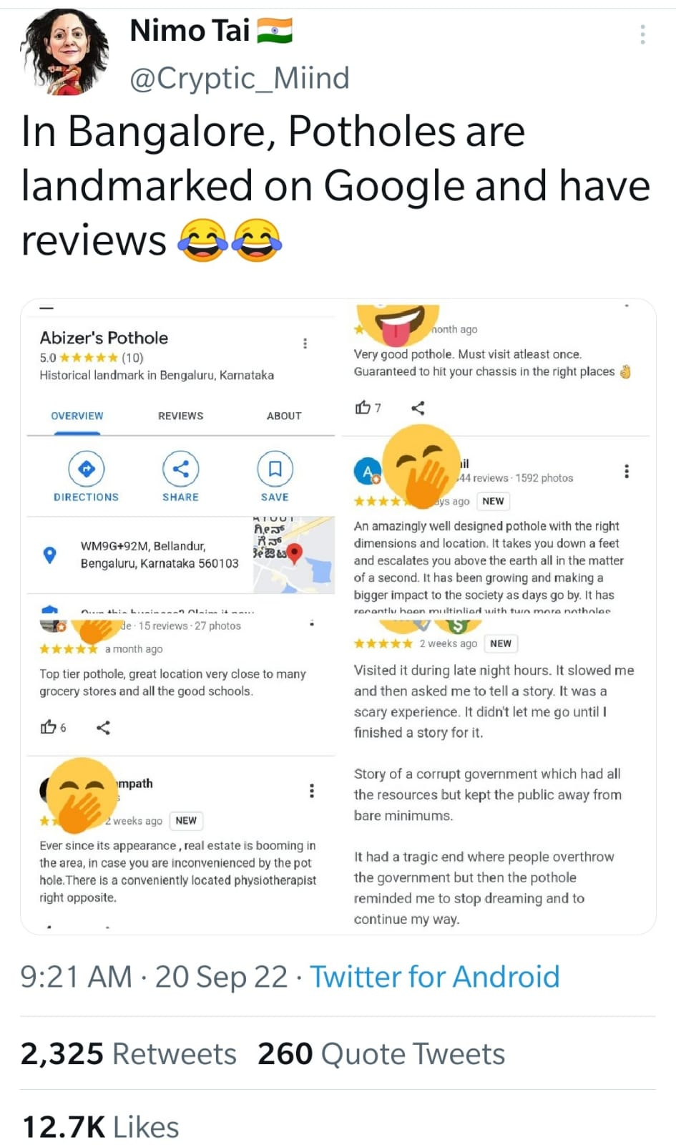
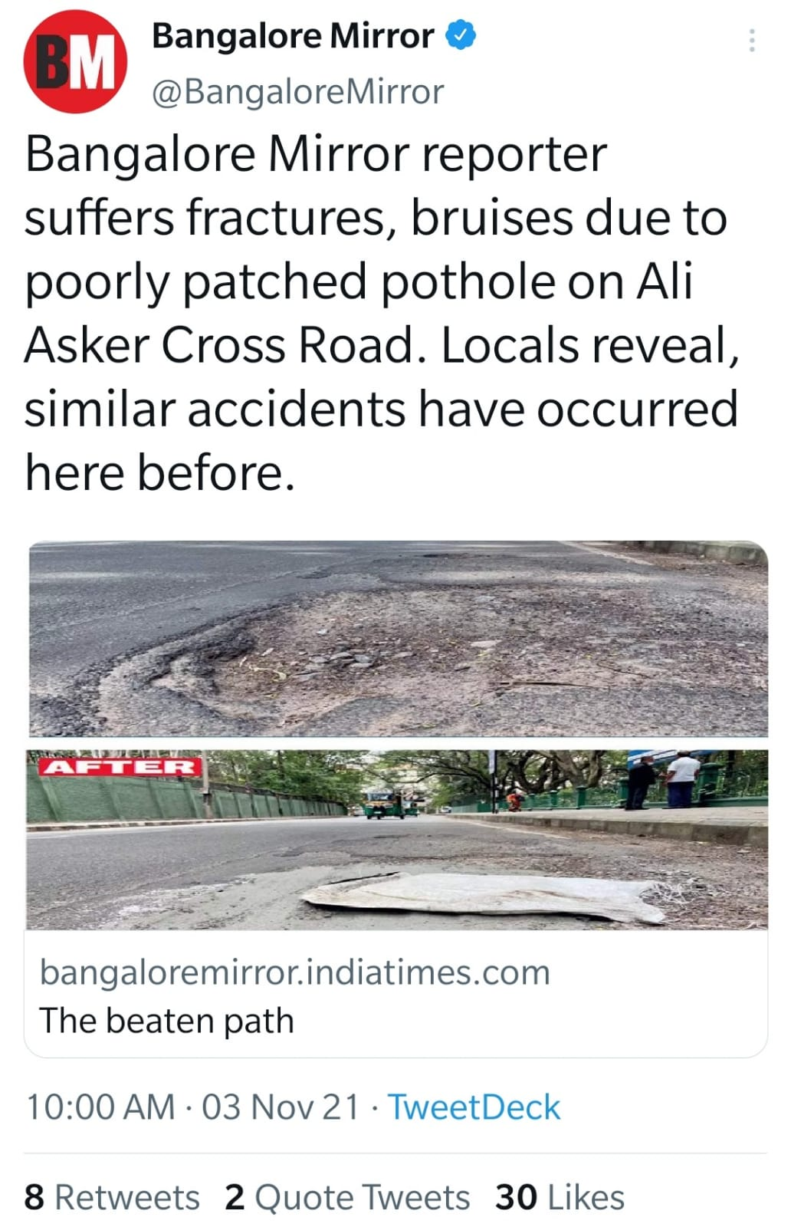
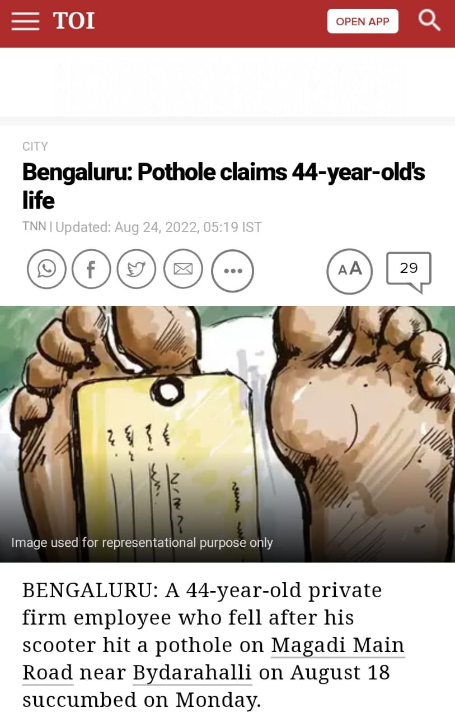
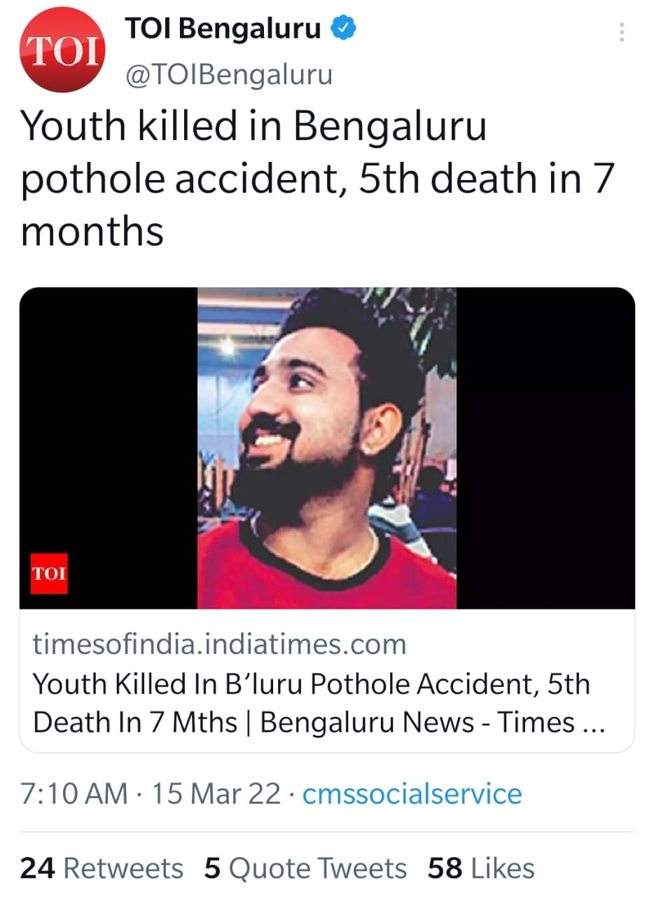
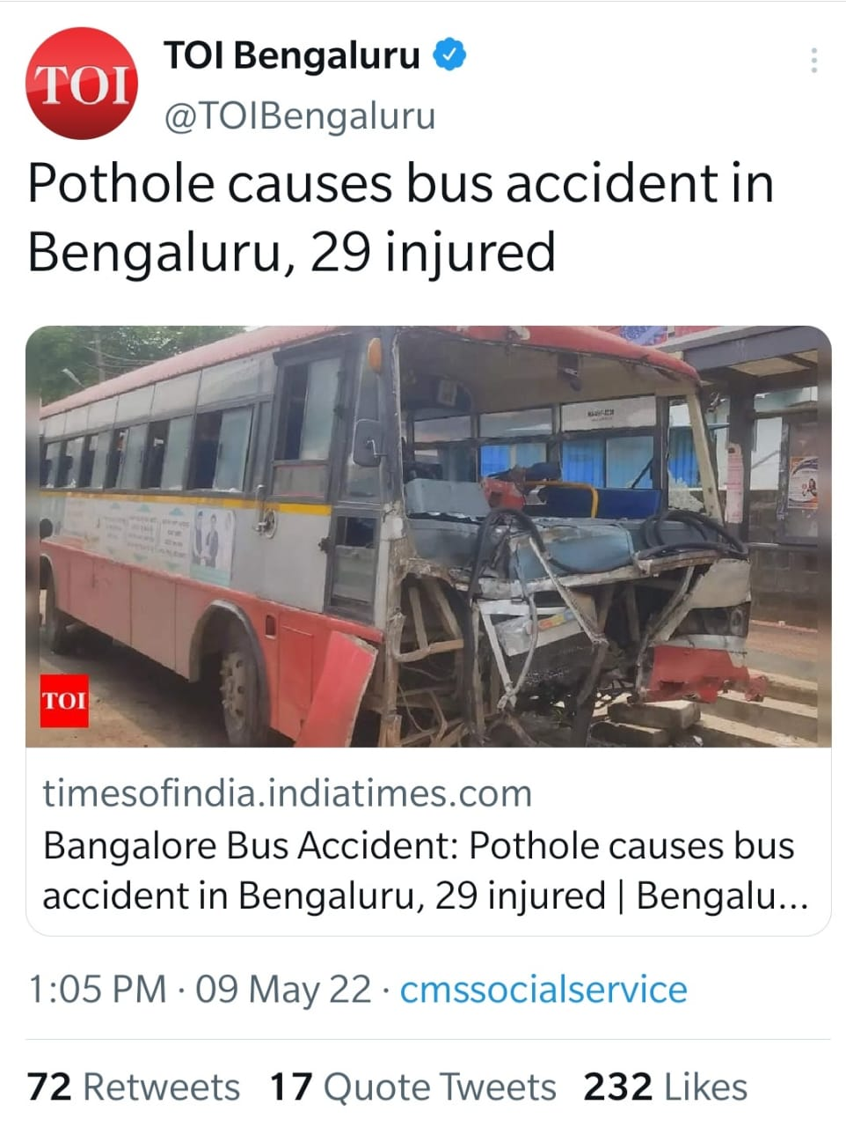
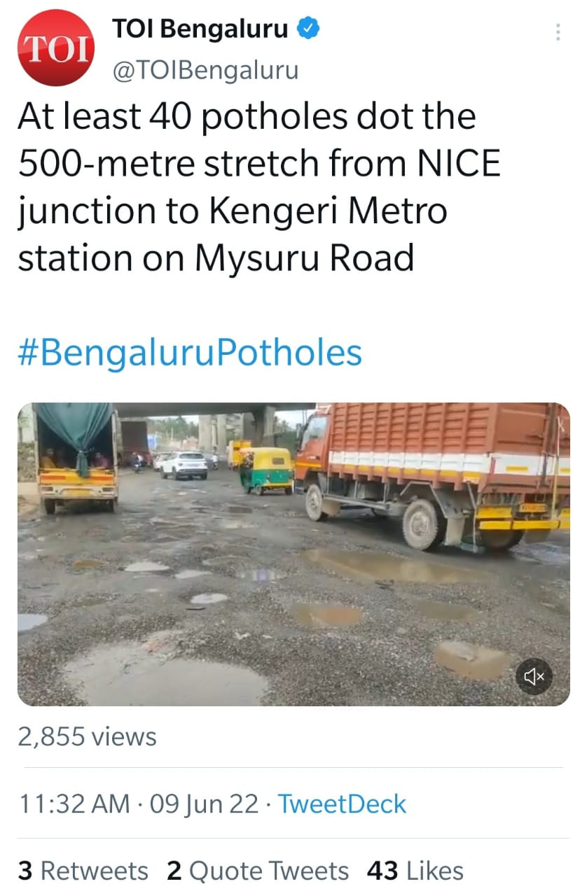
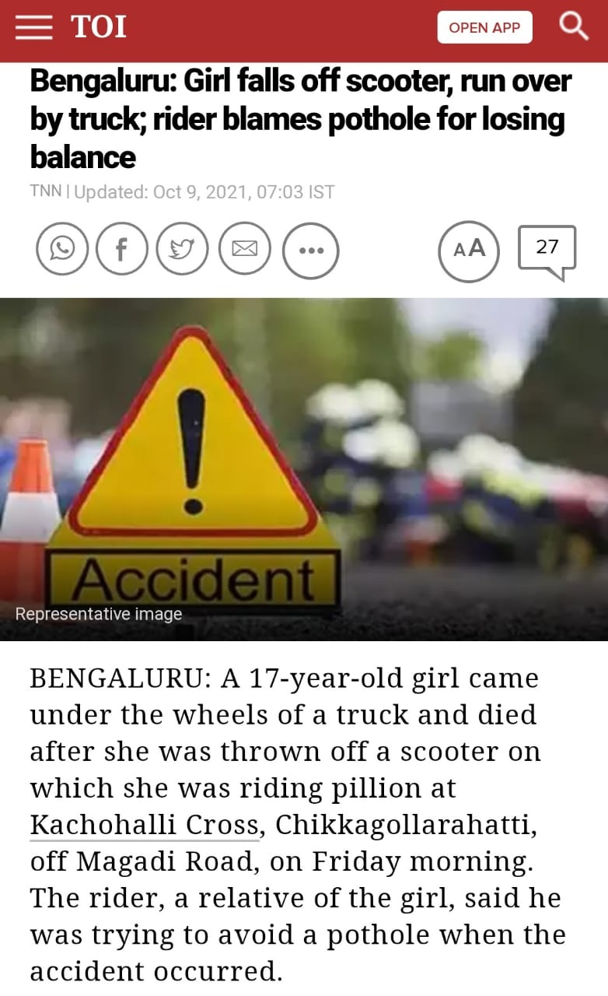
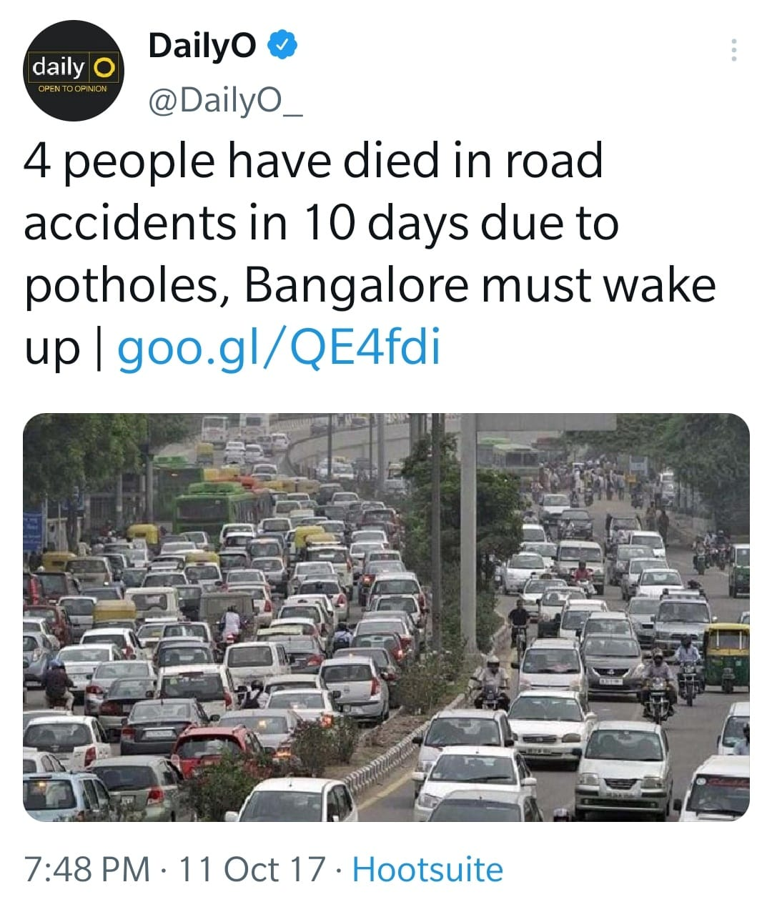
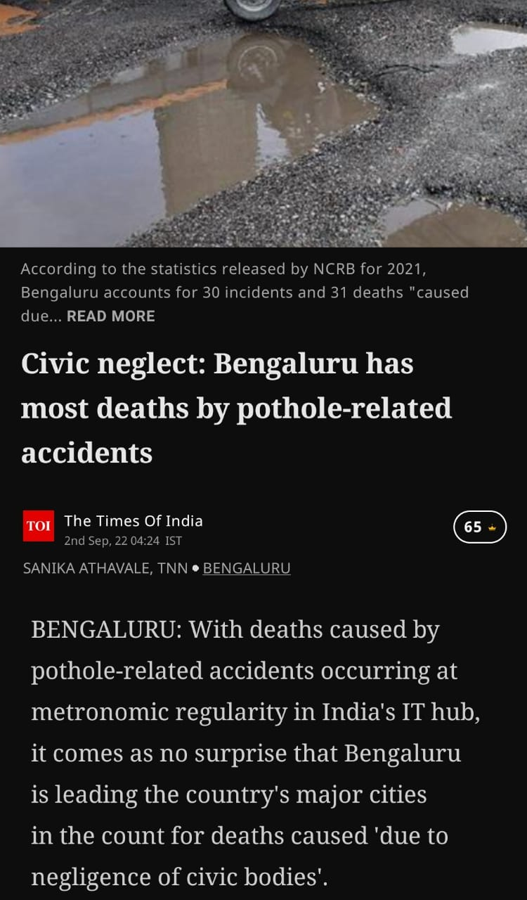
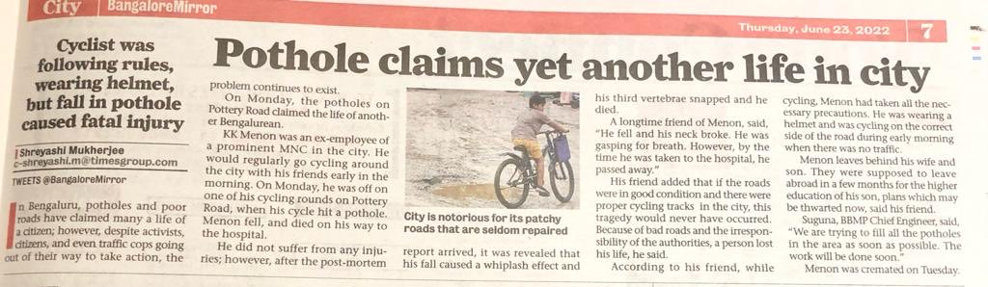

Slide 6
Proposed solution / your big Idea
To Develop a Pothole reporting Application partnering with NGOs and the public to ensure safe and pothole free India.
Our App “Victory Road” performs that precise action. When a citizen comes across a pothole, all they need to do is submit a picture of it and give access to their current location, and the partnering NGOs will be notified of it. This creates a sense of responsibility among the public, who would otherwise not feel like they had any.
The App includes an easy Pothole Tracking feature that uses latitude and longitude to allow NGOs to accurately trace and repair potholes rather than wasting valuable time searching for potholes with vague information provided by public via email or address.
TECHNOLOGY USED:
HTML,CSS(Cascading Style Sheets),JavaScript: Used to design an attractive frontend of the Application “Victory Road”.
PHP: General purpose scripting language to connect frontend to backend of the web application and execute SQL queries.
MySQL Relational Database System: used to perform operations on the database and execute queries.
XAMPP: software stack that consists of the Apache web server, MariaDB database and interpreters for scripts written in PHP language.
HTML Geolocation API: To get the geographical position of a user.

Slide 7
How does your innovation create 360° value?
1. CLIENT
We create value to our clients—NGOs and Public by delivering their goals and creating meaningful experiences.
NGO: to accurately trace a pothole.
Public: to report a pothole in a simple and hustle-free approach and also take their feedbacks.
2. TALENT
provides opportunities to volunteer, new leadership and improved collaboration. It is no longer enough to be the best in the world; it is now necessary to be the best for the world! A desire for meaningful work, as well as a strong motivation to deliver on the promise of Technology and human ingenuity.
3. INCLUSION AND DIVERSITY
Leverages in public-private partnerships and engage citizens, employees, and the LGBT community to assist in our endeavor of making pothole-free roads. This instils a sense of responsibility and nation-building.

Slide 8
How does your innovation create 360° value?
4. EXPERIENCE
A Convenient, simple and user-friendly App for Citizens and NGOs to report and trace Potholes accurately to ensure Accident-free and Safe roads.
5. SUSTAINABLITY
A people-driven transformation approach to enable people and organizations to thrive in a sustainable manner while also reducing fuel consumption caused by traffic due to potholes.
6. FINANCIAL
Roads are fixed immediately which provides financial solution by preventing drop in Indian economy due to road accidents.

Slide 9
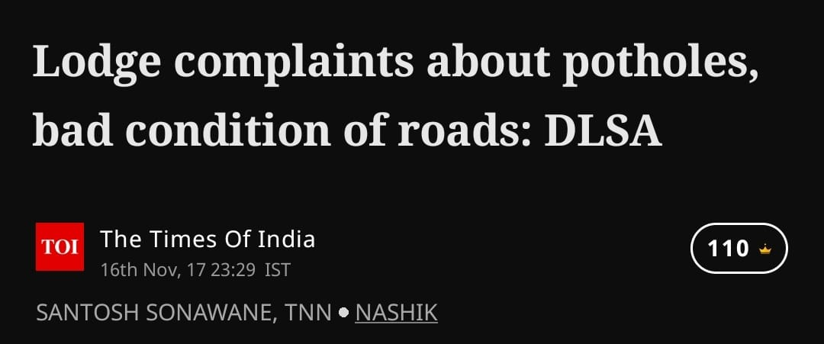
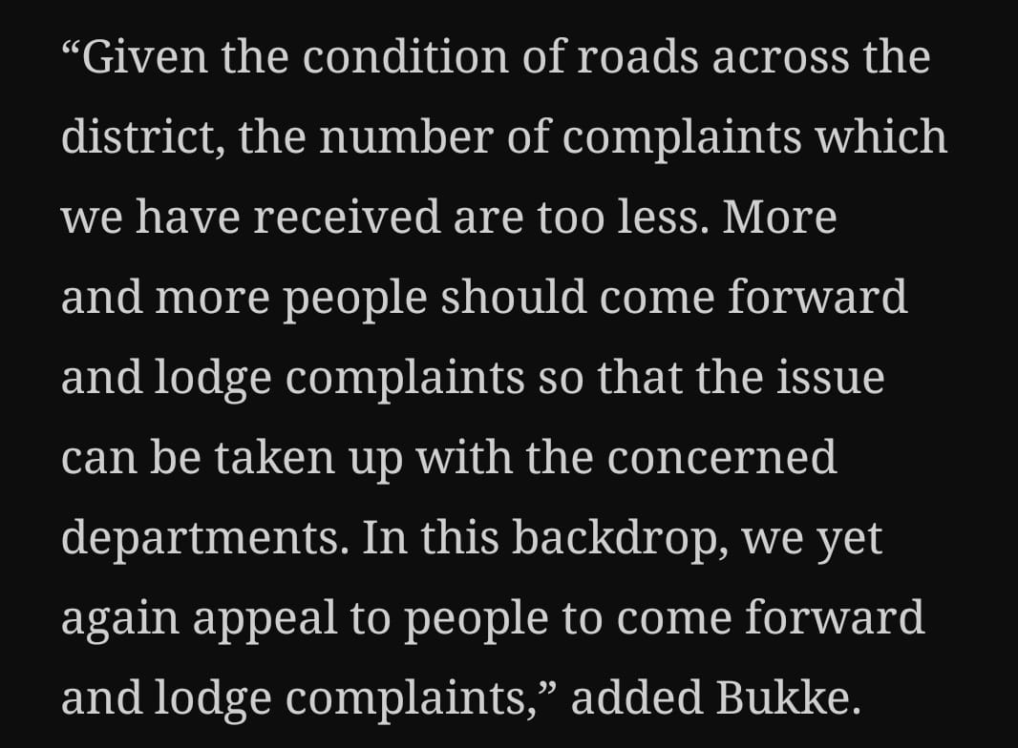
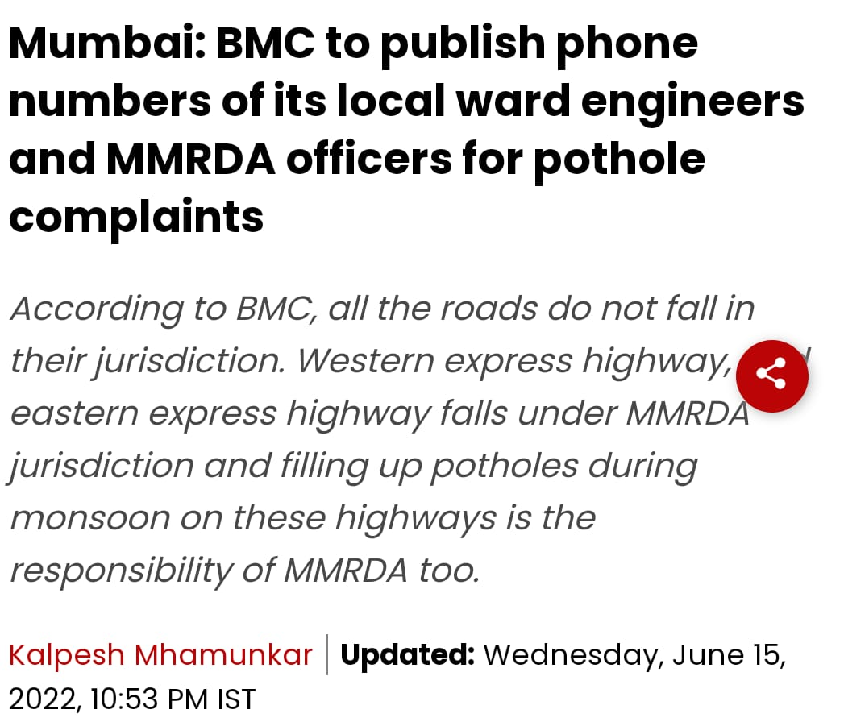
How is your solution different/unique from other solutions in market
In the light of lukewarm response from locals to filing complaints about potholes,
S.M. Bukke, secretary, DLSA Nashik, has pleaded with people to come out and voice their grievances about potholes and the poor condition of roads.
Therefore, there is a need for a convenient and simple approach for citizens to report potholes without having to visit any offices, send emails, or call the public Response Center Helpline.
Our App “Victory Road” performs that precise action. When a citizen comes across a pothole, all they need to do is submit a picture of it and give access to their current location, and the partnering NGOs will be notified of it. This creates a sense of responsibility among the public, who would otherwise not feel like they had any.
The App includes an easy Pothole Tracking feature that uses latitude and longitude to allow NGOs to accurately trace and repair potholes rather than wasting valuable time searching for potholes with vague information provided by citizens via email or address.
PATENT FILED: No
Do you have a working model/prototype: Yes
If not, will you be able to show working prototype during finale. Yes

Slide 10
Any testimonials received?
No Testimonials received, as the Application is not yet publicly hosted.

Slide 11
Elevator pitch video (1 minute) Share the public link
CLICK HERE TO VIEW ELEVATOR PITCH

Slide 12
Thank you!

